Slide 1

DreamASL - Educational and Accessibility American Sign Language Detection using Computer Vision and CNN through MediaPipe
SRM INSTITUTE OF SCIENCE AND TECHNOLOGY
COLLEGE OF ENGINEERING AND TECHNOLOGY
DEPARTMENT OF COMPUTATIONAL INTELLIGENCE
18CSP107L-MINOR PROJECT
Sourav Kumar Patra – RA2011026010282
Yash Bohra – RA2011026010296
Guide Name: Dr. K. Moorthi
Designation: Assistant Professor, CINTEL

Slide 2
INTRODUCTION
Effective communication is essential for the world to function, whether through contact, discourse, or visual expression. For those who cannot hear or speak, sign language becomes their primary means of interaction, with fingerspelling playing a crucial role in conveying names and addresses. Sign language empowers individuals with hearing impairments to express their thoughts and emotions. This project introduces a novel method for unsupervised sign language recognition, addressing the challenge of identifying alphabets and signing gestures. While various systems exist for sign language recognition, none capture complete signs. This computer vision problem holds significant potential, facilitating communication between deaf individuals and those unfamiliar with American Sign Language (ASL).

Slide 3
ABSTRACT
Sign language, vital for the hearing impaired and not universally understood, can be automatically translated into text using deep convolutional networks (DCNs).
These networks excel at learning hierarchical features, making them promising for sign language recognition. This project aims to implement DCN applications in sign language recognition, outlining various architectures. It will also address challenges, limitations, and future research prospects.
Furthermore, it will evaluate DCNs' performance on diverse sign language datasets, highlighting their accuracy in recognizing gestures.
8/18/2023

Slide 4
PROBLEM STATEMENT
There are various dumb and deaf people have their form of expressing their feelings through signs. It is very difficult for normal people to understand the exact content of symbolic expressions of these people.
It is a very challenging job that has created a communication barrier in real life. Technology is very fast growing and incredible, yet there is not much technological development and improvement for dumb deaf people.
So, the purpose of our project is aimed to enhance communication and harmony between different types of people.
8/18/2023

Slide 5
INNOVATIONS
The problem we are investigating is sign language recognition through unsupervised feature learning. Many systems are developed for sign language recognition and there is no exact system for recognizing the complete signs. Being able to recognize sign language is an interesting computer vision problem while simultaneously being extremely useful for deaf people to interact with people who don’t know how to understand American Sign Language (ASL).
Words Builder: We will add support for a words builder module that will guess words from individual letters.
Text-to-speech: We will add support for text-to-speech.

Slide 6
LITERATURE SURVEY
Sign language is a vision-based language that uses an amalgamation of a variety of visuals like hand shapes and gestures, orientation, locality, movement of hand and body, lip movement, and facial expressions. Like spoken language, regional variants of sign language also exist, e.g., Indian Sign Language (ISL), American Sign Language (ASL), and Portuguese Sign Language.
There are three types of sign languages: spelling each alphabet using fingers, sign vocabulary for words, using hands and body movement, facial expressions, and lip movement.
Sign language can also be isolated as well as continuous. In isolated sign language, people communicate using gestures of a single word, while continuous sign language is a sequence of gestures that generate a meaningful sentence.
A list of some work which is performed in the field of sign language to text translation is as:

Slide 7
LITERATURE SURVEY
1. Translation of Sign Language Into Text Using Kinect for Windows v2.
This model proposes methods to recognize and translate dynamic gestures of the German Sign Language (Deutsche Gebärdensprache, DGS) into text using Microsoft Kinect for Windows v2. Two approaches were used for the gesture recognition process: sequence matching using the Dynamic Time Warping algorithm and a combination of Visual Gesture Builder along with Dynamic Time Warping. For benchmarking purposes, eleven DGS gestures, which were provided by an expert user from Germany, were taken as a sample data set. The proposed methods were compared based on the computation cost and accuracy of these gestures. The computation time for Dynamic Time Warping increased steadily with an increasing number of gestures in the data set whereas in the case of Visual Gesture Builder with Dynamic Time Warping, the computation time remained almost constant. However, the accuracy of Visual Gesture Builder with Dynamic Time Warping was only 20.42% whereas the accuracy of Dynamic Time Warping was 65.45%. Based on the results, it was recommended to use the Dynamic Time Warping algorithm for small data sets and Visual Gesture Builder with Dynamic Time Warping for large data sets.

Slide 8
LITERATURE SURVEY
2. American Sign Language Translation Using Edge Detection and Cross Co-relation
This project is to implement an automated translation system that is capable of translating ASL to English text using common computing environments such as a computer and a generic webcam. In this project, a real-time hand gesture recognition system using a combination of image processing modalities is implemented. A prototype graphical user interface application for ASL sign capture, processing, collection, and analysis is presented. The approach consists of a gesture extraction phase followed by a gesture recognition phase. An image gesture database is collected through the application and used as training information to be used in the gesture recognition stage. This model aims to provide two different translation paradigms:

Slide 9
RESEARCH GAP/LIMITATIONS
Dependency on Hardware (Kinect): The model relies on the Kinect for Windows v2 hardware, which may limit its accessibility and usability for users who do not have access to this specific technology. Compatibility issues and the availability of the Kinect device could be barriers to widespread adoption.
Language Specificity: The model focuses on translating German Sign Language (DGS). Adapting it to other sign languages would require significant additional development and data collection, limiting its applicability to a broader user base.
User Expertise: The study mentions that the DGS gestures were provided by an expert user. The model's performance might not generalize well to interactions with individuals who use sign language in diverse ways or who have varying levels of expertise.
Real-world Variability: The study may not have fully accounted for real-world variability, such as different lighting conditions, background noise, and variations in how people naturally perform sign language gestures.
Real-Time Processing: Real-time processing of hand gestures can be computationally intensive, especially on standard computer hardware. This could lead to delays in gesture recognition and translation, impacting the system's usability.

Slide 10
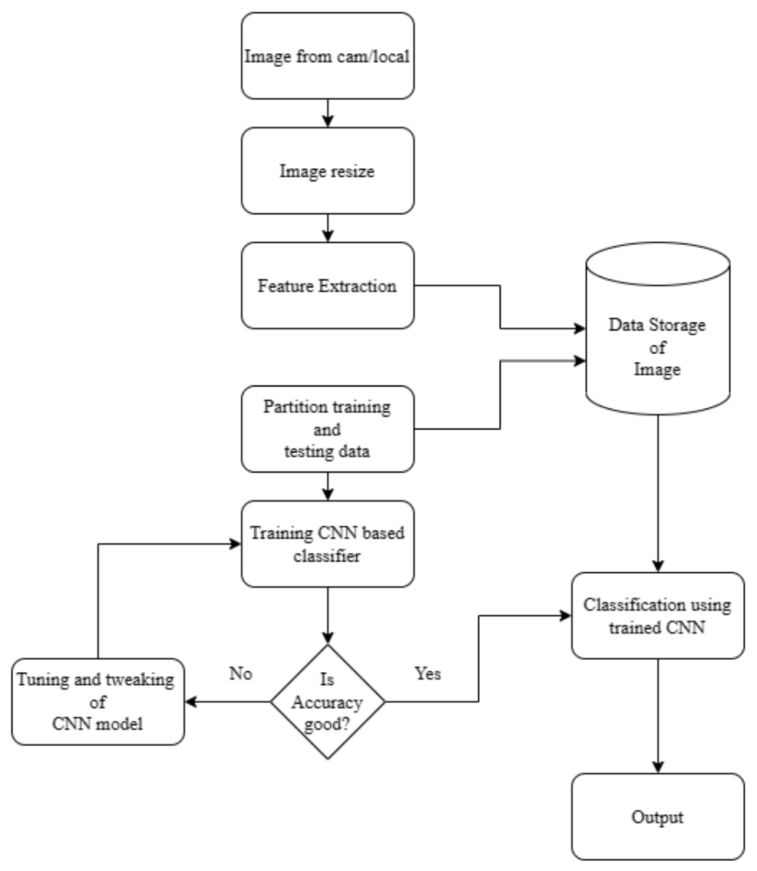
SYSTEM ARCHITECTURE DIAGRAM

Slide 11
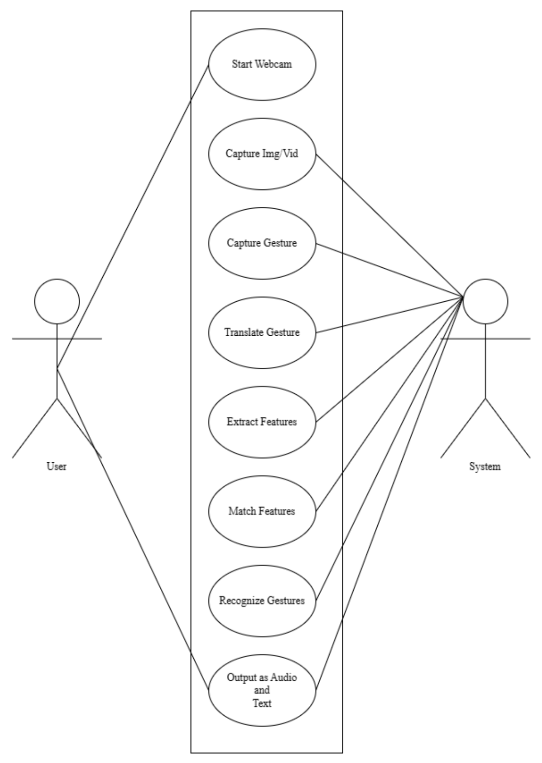
USE CASE

Slide 12
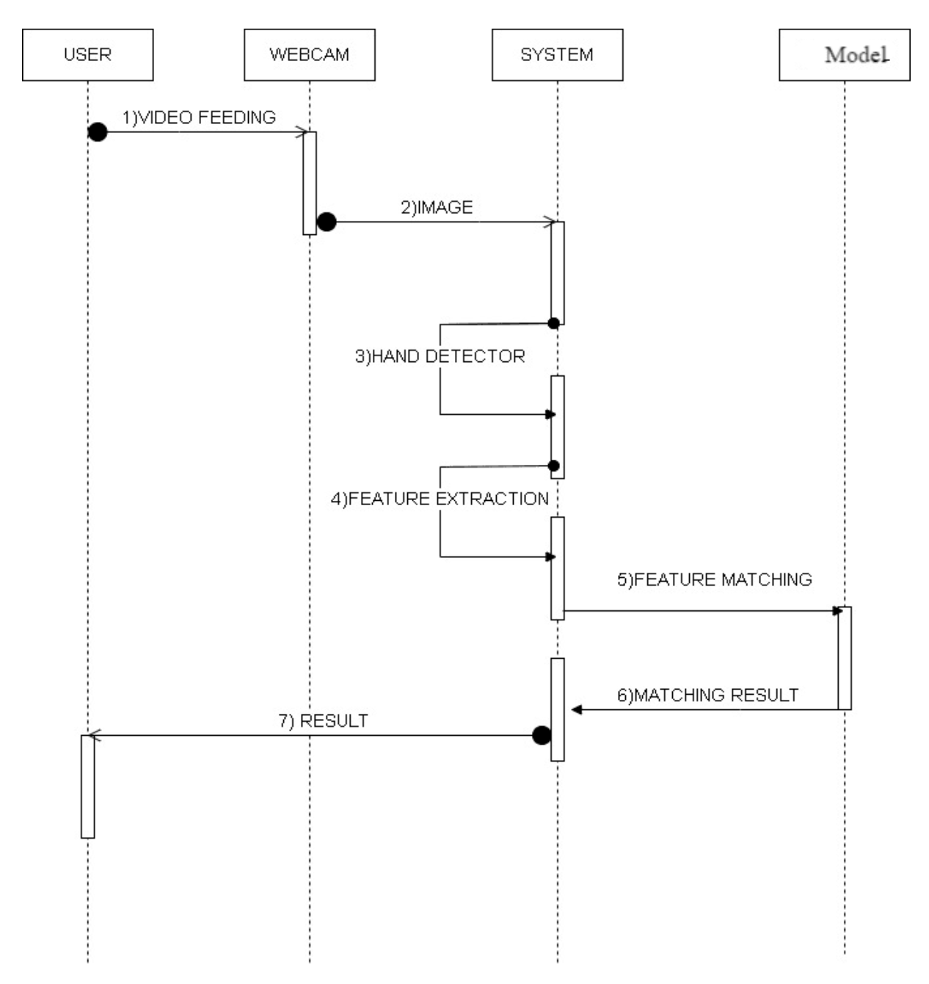
SEQUENCE DIAGRAM

Slide 13
Modules
Data Preprocessing Module
Data Collection Module
Hand Gesture Detection Module
CNN Feature Extraction Module

Slide 14
Module 1
Data PreProcessing Module
.
Eliminate outliers and errors to ensure data quality.
Ensure variations in lighting conditions, backgrounds, and hand shapes to improve model robustness.
Remove any noise or irrelevant information from the collected data.
Use OpenCV library for web camera input handling and preprocessing, such as greyscaling, image resizing and noise removal.

Slide 15
Module 2
Data Collection Module
The dataset for American Sign Language (ASL) recognition was obtained by capturing images of hand gestures representing every alphabet using the Mediapipe hand tracking library.
The hand-tracking library provided a fast and reliable way to detect hand landmarks and track hand movements in real time.
The captured hand gestures were then mapped onto a white background image, which provided a consistent and neutral background for image processing and classification.
The resulting dataset can be used to train machine learning models for ASL recognition and assistive technology applications.

Slide 16
Module 3
Hand Gesture Detection Module
This module captures images of hand gestures representing each alphabet using the Mediapipe hand tracking library.
The library employs a deep learning-based approach to detect and track human hands in real time, leveraging a lightweight convolutional neural network (CNN) model trained on millions of hand images to identify hand landmarks and their connections.
It begins by detecting hand regions in input images with bounding box regression.
The detected hand regions are then processed by a hand landmark model, which generates a set of 21 2D points representing hand joints and fingertips.
The model is trained on a combination of synthetic and real data. This allows it to then generalize across different hand shapes, skin tones, and lighting conditions.
These hand landmarks can be used for various applications, including gesture recognition and hand pose estimation.

Slide 17
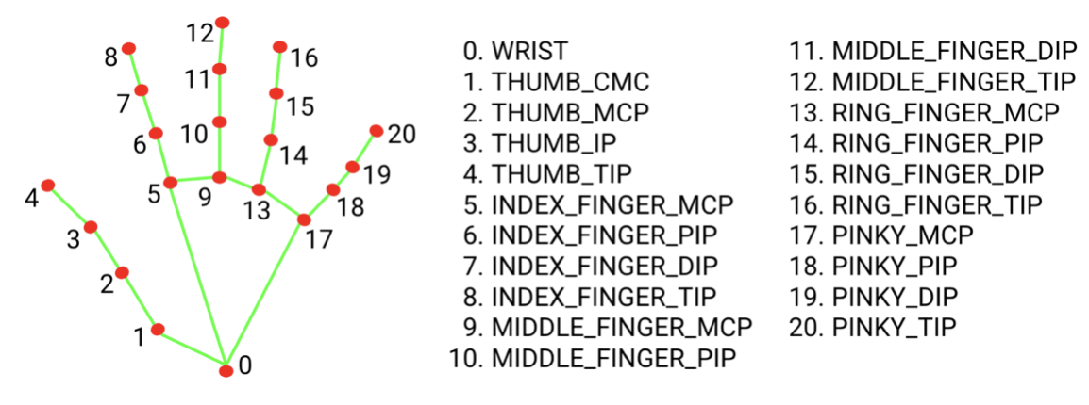
MODULES

Slide 18
Module 4
CNN Feature Extraction
This module employs Convolutional Neural Networks (ConvNets or CNNs) to analyze and extract spatial features from the captured frames of video sequences.
CNNs are particularly adept at capturing local spatial patterns in data, making them suitable for image-based tasks.
The project uses the Inception-v3 model from the TensorFlow library, a deep ConvNet designed for image classification.
Inception-v3's capability to extract spatial features is harnessed to process the video frames and interpret ASL gestures.
CNNs are robust to variations such as image rotation or translation, ensuring reliable recognition of hand gestures.

Slide 19
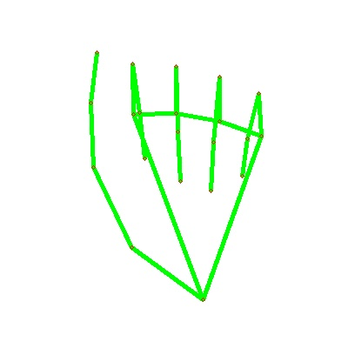
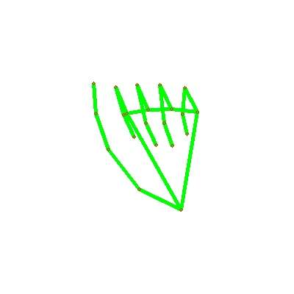
Results
The letter A - 2 slightly different variations recorded in database through Data Collection module

Slide 20
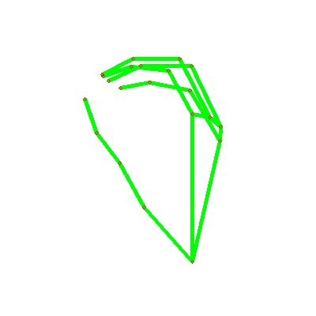
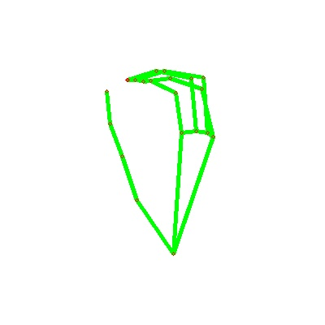
Results
The letter O - 2 slightly different variations recorded in database through Data Collection module

Slide 21
Results and Discussion
We have used Preprocessing (powered by OpenCV) and Data Collection (powered by MediaPipe) module to process and capture multiple images of each letter of the alphabet, allowing for multiple slight variations of the fingers for each letter.
We will then train our model on this dataset, thereby providing a greater resilience to environmental and operator variations.
Capturing multiple images for each letter is therefore essential to ensure the robustness of the model.

Slide 22
REFERENCES
[1] Dhiman, M., 2021. Summer Research Fellowship Programme of India's Science Academies 2017. [online] AuthorCafe.
[2] T D, Sajanraj & M V, Beena. (2018). Indian Sign Language Numeral Recognition
Using Region of Interest Convolutional Neural Network.
[3] Chen, J., 2021. CS231A Course Project Final Report Sign Language Recognition
[4] P.Amatya,k.Sergieva & G. Meixener," Translation of Sign Language Into Text Using Kinect for Windows v2".
[5] A. Joshi, H. Sierra & E. Arzuaga," American sign language translation using edge detection and cross-correlation".
[6]. Pigou, L., Dieleman, S., Kindermans, P.-J., Schrauwen, B.: Sign language recognition using convolutional neural networks. In: Workshop at the European Conference on Computer Vision 2014, pp. 572–578. Springer International Publishing (2014).
[7]. Sharma, R., Bhateja, V., Satapathy, S.C., Gupta, S.: Communication device for differently abled people: a prototype model. In: Proceedings of the International Conference on Data Engineering and Communication Technology, pp. 565–575. Springer, Singapore (2017)
[8]Thomas Noltey, Hans Hansson, Lucia Lo Belloz,” Communication Buses for Automotive Applications” In Proceedings of the 3rd Information Survivability Workshop (ISW-2007), Boston, Massachusetts, USA, October 2007. IEEE Computer Society.
[9] R. S. Pressman, Software Engineering (3rd Ed.): A Practitioner’s Approach. New York, NY, USA: McGraw-Hill, Inc., 1992.

Slide 23
Thanking You
8/18/2023

